Slide 1
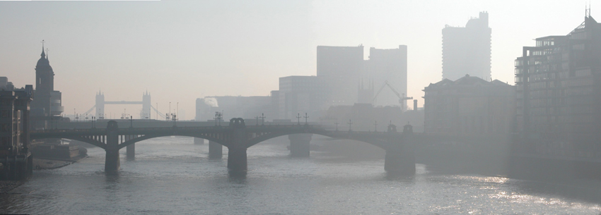
English Business Culture

Slide 2
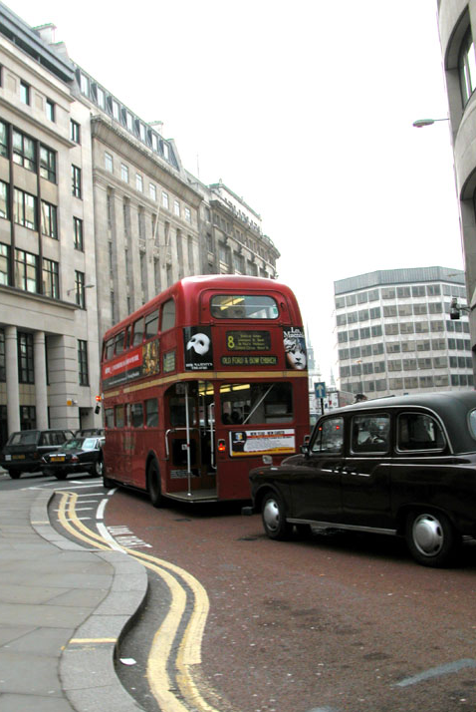
Business Module Contents
Making Appointments
Telephone Etiquette
Receiving Clients
Business Dress Code
Addressing Others
Negotiation
Entertaining
Public Behaviour
Regional Differences
How to start a business in England
Final Test
<< BACK
NEXT >>
QUESTIONS

Slide 3
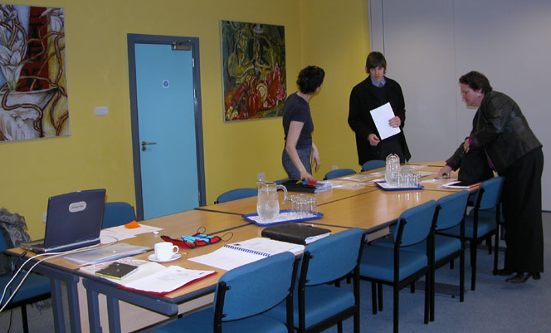
Making appointments
MENU
It is often difficult to set up a meeting with someone you have not met before, or do not have a personal connection with as the `old boys’ network’ is alive and well in English business. Business people like to do business with people they know.
Great importance is placed on recommendations or referrals from colleagues or acquaintances, which sometimes makes it difficult for `new faces’ to make appointments with more established business people.
<< BACK
MORE …
NEXT >>
QUESTIONS

Slide 4
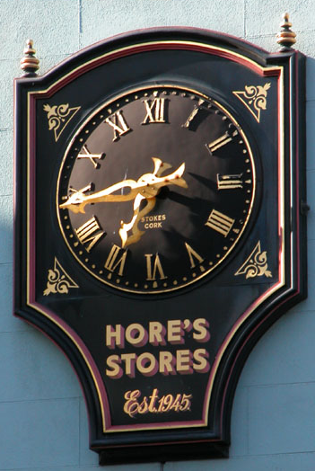
Making appointments
MENU
Be punctual!
Time is an important factor in English business culture – diaries are strictly managed whenever possible.
Meetings are often arranged on a very tight schedule, and if one starts late, or runs over time it will affect the rest of the schedule. Contact the other party and inform them if you are going to be late; this gives them the opportunity to re-arrange your meeting for another date, or to change their routine to make up for the delay.
<< BACK
NEXT >>
QUESTIONS

Slide 5
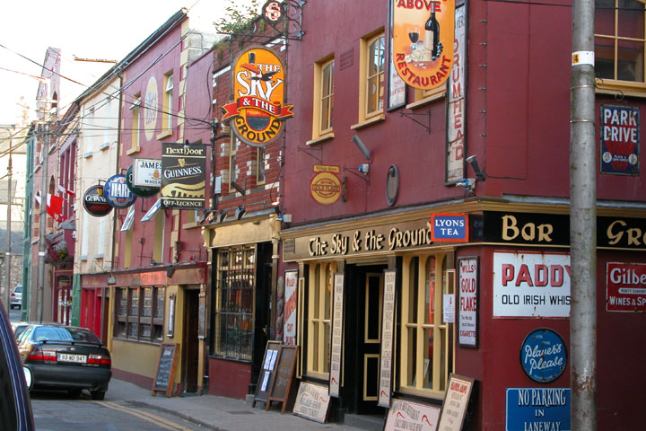
Making appointments – Business Hours
MENU
Opening hours vary but the usual hours of business are as follows:
  Banks: 9am – 5pm
  Retailers: 10am – 6pm (there is usually late night shopping in cities on one night of the week, where shops remain open until 9pm)
  Service organisations: 8.30am – 8.30pm (these are usually telephone centres, staffed by shift workers)
  Office hours: 9am-5pm
Lunch breaks are normally taken between 12 and 2pm, most lasting from 30 minutes to an hour
<< BACK
NEXT >>
QUESTIONS

Slide 6
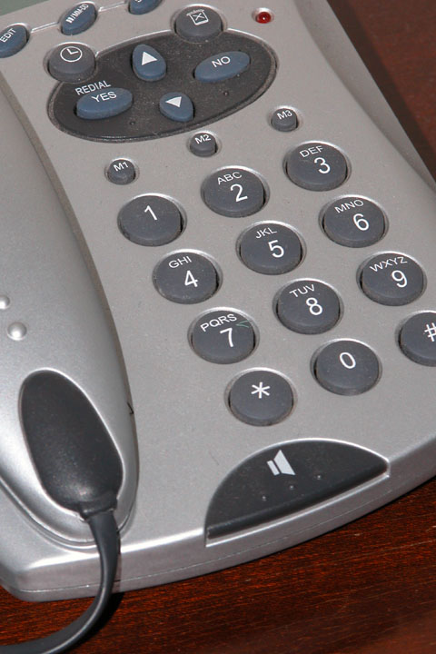
Telephone Etiquette
MENU
In England, telephone manner is polite and efficient. Employees are expected to answer the telephone whenever possible within 2 rings.
Callers will be greeted courteously (eg: “good morning”/ “good afternoon”), being given the name of the company they are calling, and the name of the person to whom they are speaking.
In some companies, a receptionist answers all calls, welcoming the caller and passing them on to the correct person or taking a message.
However, not all companies have a receptionist to direct calls, and you may find yourself leaving a message on an answering machine, or with a messaging service. This is becoming the `norm’ in single proprietor businesses. The system is very reliable, so don’t be put off!
Larger service organisations (eg: the gas board, banks) may use a menu-driven electronic call handling system, asking you to choose options from ever-decreasing menus until you get through to the correct department or person to reduce time spent on the phone by the customer and their employees.
ATTACHMENTS
<< BACK
MORE …
NEXT >>
QUESTIONS

Slide 7
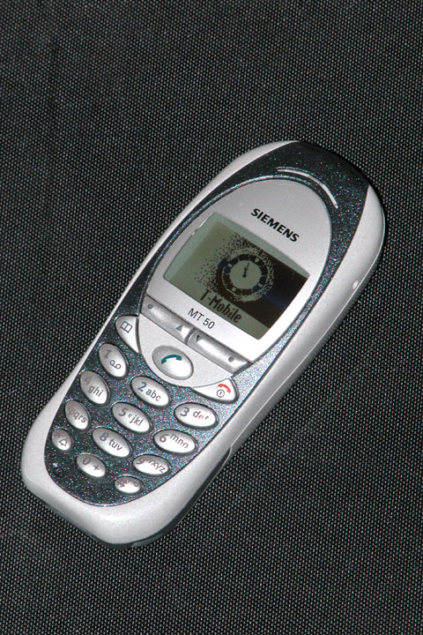
Telephone Etiquette – Mobile Telephones
MENU
Mobile telephones are ever-increasingly used, in business and personally, and in some cases the only means of contacting a business will be through a mobile number. There are several important points to remember about using mobiles:
  Mobiles should be switched off or put on silent mode during meetings
  Text messaging is not acceptable during meetings
  Business people do have private lives, so it is best not to call a business contact’s mobile outside office hours unless you have been invited to do so.
Also, it is illegal to use a hand-held mobile whilst driving.
ATTACHMENTS
<< BACK
NEXT >>
QUESTIONS

Slide 8
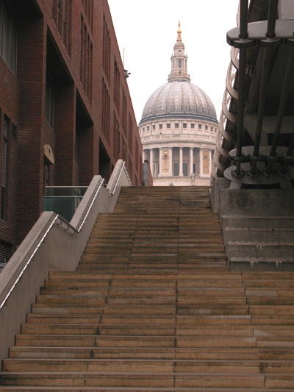
Receiving Clients
MENU
First impressions count!
The `look’ of your business is crucial as this is what you are judged on when clients visit for the first time
  Have a tidy office space
  Wear appropriate business dress for your industry
  Use appropriate language
  Be professional
<< BACK
MORE …
NEXT >>
QUESTIONS

Slide 9
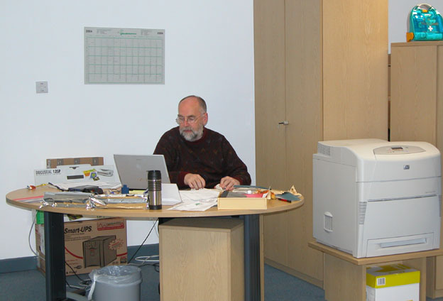
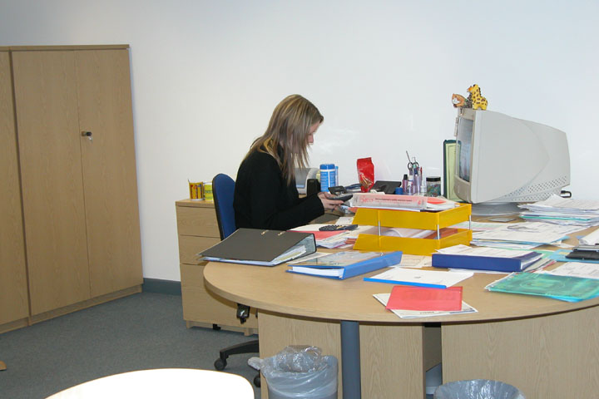
Receiving Clients
MENU
English businesses have adopted an open-plan office approach in recent years; most employees sit in a large room, with only senior managers having an office of their own. This can make receiving clients difficult, so do not be surprised if you are directed to a separate meeting/ conference room in the building rather than your host’s `office’.
<< BACK
NEXT >>
QUESTIONS

Slide 10
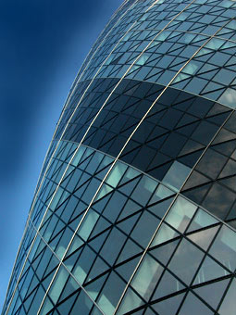
Receiving Clients - Customer Service
MENU
Customer Service was previously poor in many English shops, offices and restaurants. However, customer service has become more of a focus in recent years as customers’ expectations have risen regarding efficiency, good manners and quality as the basis on which they will part with their money. This has happened largely due to the increase in options available to the consumer.
Most businesses have invested in a quality customer experience, improving customer reception areas and instilling a customer care ethos in those employees that are customer facing (eg: receptionists, sales people, financial services)
<< BACK
NEXT >>
QUESTIONS

Slide 11
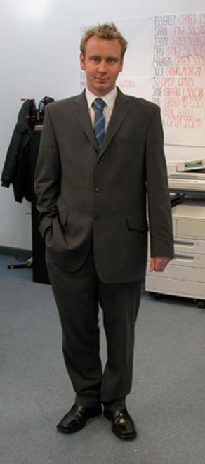
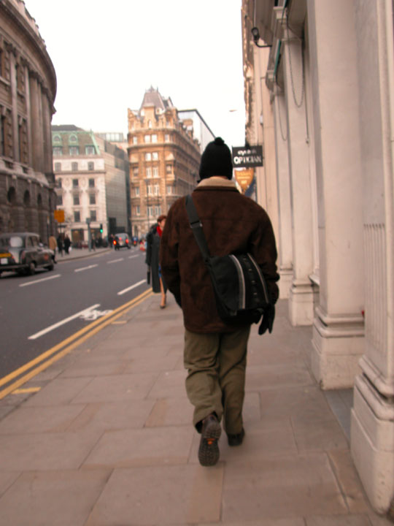
Business Dress Code
MENU
There is not a set business dress code in English business culture. Appropriate business dress varies considerably depending on where you are located, the industry you work in and your role within the business.
As modern business becomes established, many of the traditional `norms’ are disappearing. No longer does your attire accurately reflect your role and status within your company (or society for that matter) unless your industry is more traditional in its approach.
ATTACHMENTS
<< BACK
MORE …
NEXT >>
QUESTIONS

Slide 12
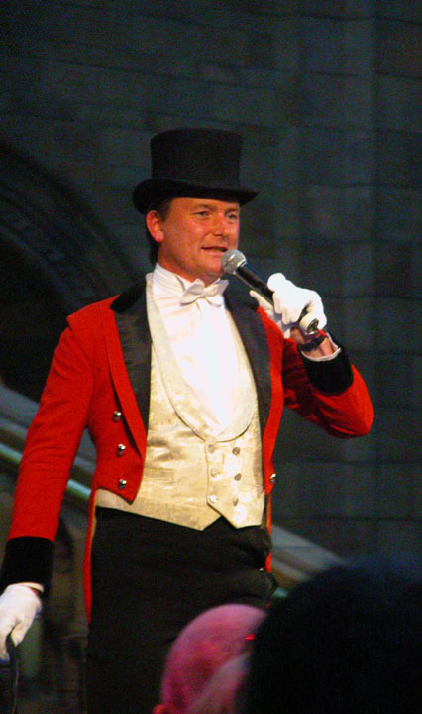
Addressing Others
MENU
When addressing people for the first time it is advised to use their title and surname rather than their first name. Continue to do so until they invite you to use their first name – usually this will happen at the first meeting as the general trend is for English business culture to be more relaxed and personable.
It is safest to address women as `Ms’ unless you know that they are a `Miss’ or `Mrs’ – and even then, they may prefer `Ms’.
You may find that employees in retail outlets will use `terms of endearment’ such as `dear’, `chuck’, `duck’, `love’ when addressing customers; these are used mainly by older employees and are not meant as an insult.
<< BACK
MORE …
NEXT >>
QUESTIONS

Slide 13

Negotiation
MENU
Negotiation in English business culture can be a little bumpy unless you know the basic rules.
Relationship marketing is the preferred way of doing business in England; building and maintaining mutual partnerships is crucial to surviving in a very competitive business environment.
Business networking is extremely important; attendance at industry conferences and exhibitions is a good way to meet others in the same industry as yourself. You may find business partners at these events.
Building a relationship on a 1:1 basis reaps far greater rewards than mass mailings or telesales ever could. As a result there are still travelling sales people who call on small rural businesses to maintain established relationships.
<< BACK
NEXT >>
QUESTIONS

Slide 14
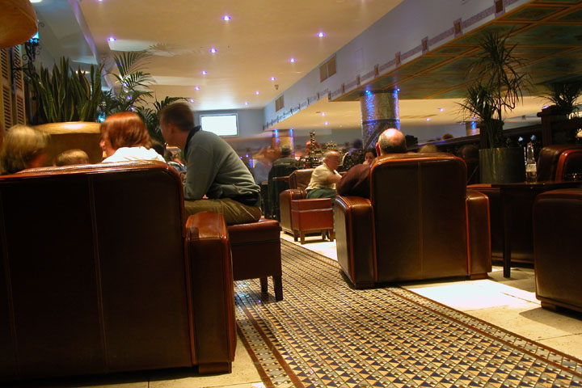
Negotiation
MENU
First meetings are usually held in the office, but once a comfortable relationship has been established, a lot of business is done by telephone.
Negotiating large deals are usually face-to-face meetings, and are sometimes over a meal – breakfast, lunch or dinner.
Business cards are exchanged at the beginning or end of meetings
Appearances are all important:
  Make sure that you are on time
  Be appropriately dressed for the occasion
  Ensure that you are organised and have planned what you want to say
Speak, don’t shout or get too excited; the English prefer moderate behaviour
<< BACK
MORE …
NEXT >>
QUESTIONS

Slide 15
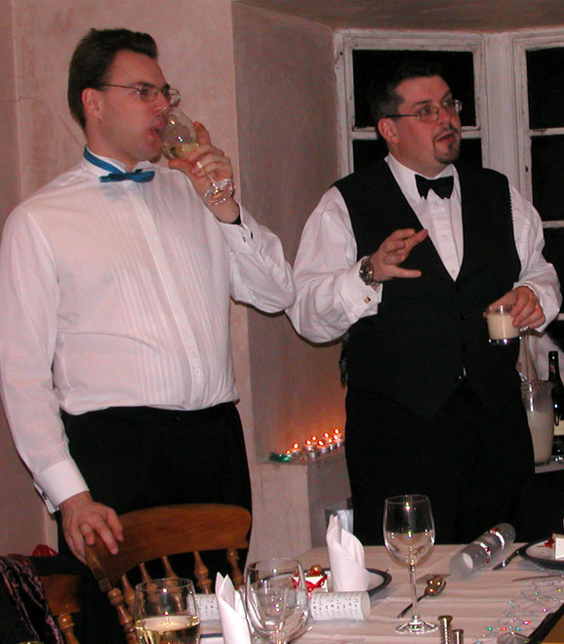
Entertaining
MENU
Some business is still conducted in a social setting although long business meals, with copious amounts of food and alcohol, are not as common as they once were.
As an overseas visitor you may be invited to dinner by your host; this may be at your host’s home or in a restaurant.
Gifts are not expected in English business culture, and there are often strict company policies regarding the acceptance and giving of corporate gifts.
<< BACK
NEXT >>
QUESTIONS

Slide 16
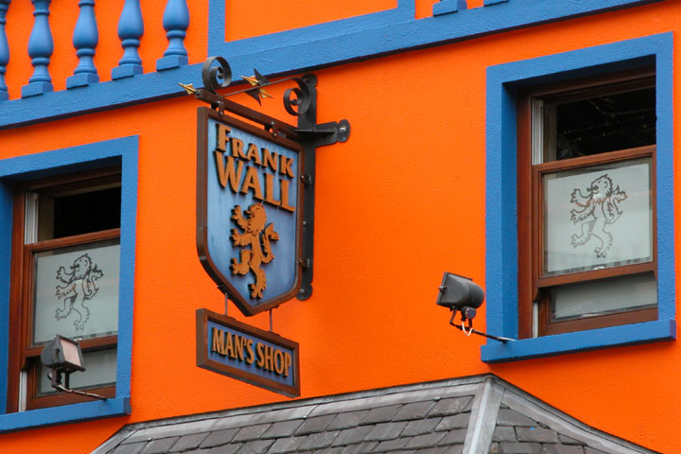
Entertaining
MENU
If invited to your host’s home, a bouquet of flowers or a bottle of wine is usually an acceptable offering. Your conversation will probably be of a more general nature, and `shop talk’ is not encouraged. Dress code depends on the type of gathering; if an informal dinner then smart casual (smart trousers and a collared-shirt, possibly a sports jacket) is acceptable; a more formal dinner party will require a suit. When in doubt ask your host!
Being invited to a restaurant usually implies that spouses/ partners are not attending, and that business/ industry talk will dominate. Business suit is the best wardrobe option, unless otherwise informed. Your host will pay for dinner – and your host will usually be the most senior member of the company at the table.
A point to remember when eating out: waiters and waitresses will expect a tip of 10%. Many restaurants now include an automatic service charge – check the bill before you pay.
You may be invited for drinks after work at a local pub. These usually last for about an hour and will sometimes include dinner, but do not count on this.
Wherever you are entertained, do not flirt with other company employees at social events; the English do not approve of `office romances’ or sexual relationships between colleagues.
<< BACK
NEXT >>
QUESTIONS

Slide 17
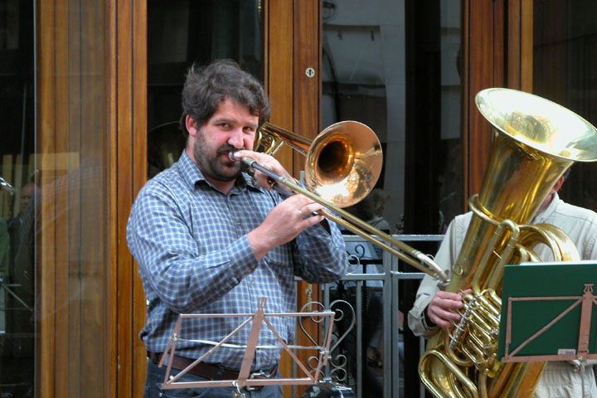
Public Behaviour
MENU
The apparent informality in the workplace spills into public areas too.
Sunny weather draws business people into the parks during lunchtime where they will remove shoes and jackets and roll up sleeves to soak up as much sun as possible.
Chewing gum is not encouraged in the workplace, but is chewed constantly elsewhere.
Smoking is not yet banned in all public places (although Ireland has recently introduced a ban on smoking in all enclosed public spaces), but be aware of `no smoking’ signs as you enter buildings – most do not allow smoking.
Swearing is generally not encountered in office environments, but bad language is common on the streets.
<< BACK
NEXT >>
QUESTIONS

Slide 18
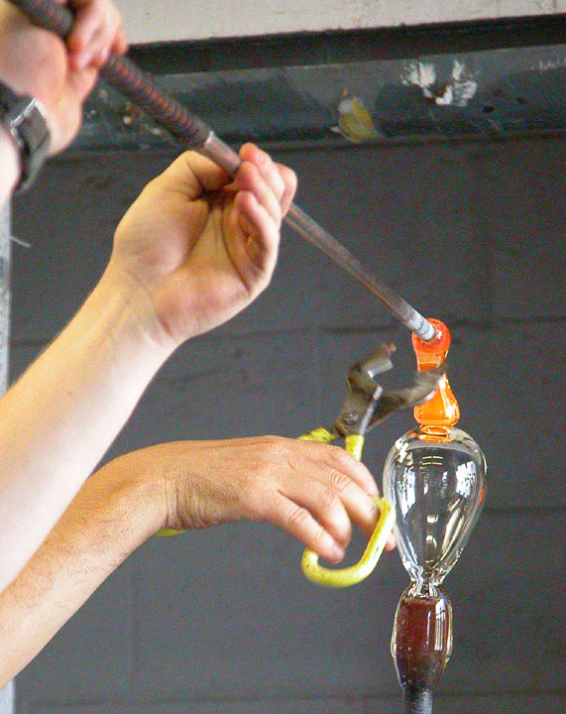
Regional differences
MENU
Manufacturing is no longer the main industry in England; we are now primarily a service industry – providing financial, IT (Information Technology) and consultancy services to clients.
However, there is still some regional differentiation
Banking headquarters are mainly based in London as this is the financial capital of the country
The majority of businesses in the South are large corporations and service industries.
The West Midlands is still heavily involved in the car manufacturing industry, while the East Midlands is being regenerated following the fall of the mining industry – the growth of small specialist companies is being encouraged.
The North and Wales are still predominantly agricultural, but other businesses are continuing to emerge around this industry, particularly tourism.
<< BACK
MORE …
NEXT >>
QUESTIONS

Slide 19
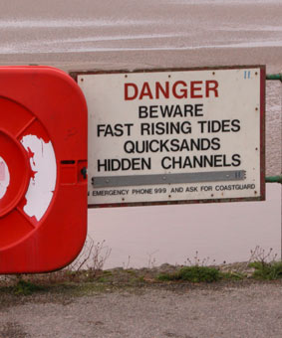
How to start a business in England
MENU
There is an increase in the number of small to medium sized companies (SME’s) emerging in England to offer niche/ specialist services that larger businesses cannot provide, as well as an increase in the number of self-employed people for the same reason.
There is more support than ever before for those people setting up their own businesses. Business Link is an example of one of the government run organisations that specialise in giving practical help and advice to those people interested in setting up their own business (see www.businesslink.gov.uk for more information on their services)
There is expert advice available through radio and television stations (for example: www.newsbbc.co.uk ), banks and other private consultancy firms on setting up your own business and the potential obstacles as well as benefits of being your own boss!
The Chartered Management Institute has a wealth of information regarding the set up of small businesses in England, so have a look at www.managers.org.uk/institute for inspiration.
<< BACK
MORE …
NEXT >>
QUESTIONS

Slide 20
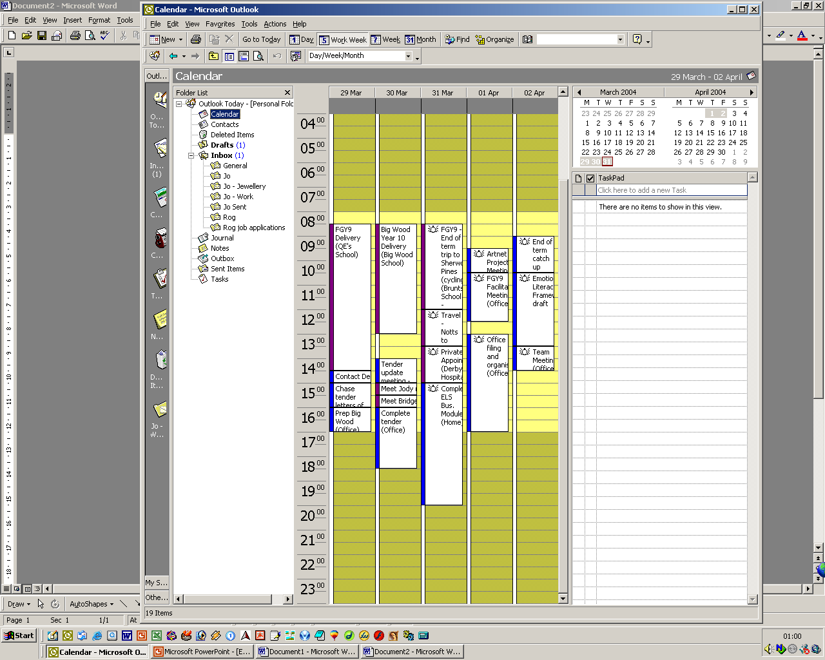
Making appointments
MENU
Meetings are usually set up through a personal assistant or administrator as they will be the `diary keeper’ for senior management. Before scheduling a meeting they will ask questions to make sure that the time spent in the meeting will be worthwhile.
Appointments are best arranged for between 10am and 12pm, or after 2pm.
Although more people take vacations during August than at other times of the year, few businesses close over summer. However, many businesses will shut between Christmas and New Year.
<< BACK
NEXT >>
QUESTIONS

Slide 21
Making appointments – Meeting Etiquette
MENU
Agenda
An agenda should be drafted in advance of the meeting so that there is a clear focus for discussion, and it usually allows for other topics to be raised at the end of the meeting if necessary.
See attachments for an example of an agenda
Meeting Minutes
Minutes are taken at the meeting (either by a PA/ the meeting host)
These are a record of the discussion and a reference for any further action points, deadlines and responsibilities.
These minutes should be typed and sent out to relevant parties within a week of the meeting
  Professional appearance is important.
  Dress appropriately for your meeting.
  Ensure that any materials/ paperwork you have is professionally presented, and that any presentations make use of current technology.
See attachments for 2 examples of meeting minutes – the format can be specific to the organisation, as long as
there are action points and comments on actions already completed
ATTACHMENTS
<< BACK
NEXT >>
QUESTIONS

Slide 22
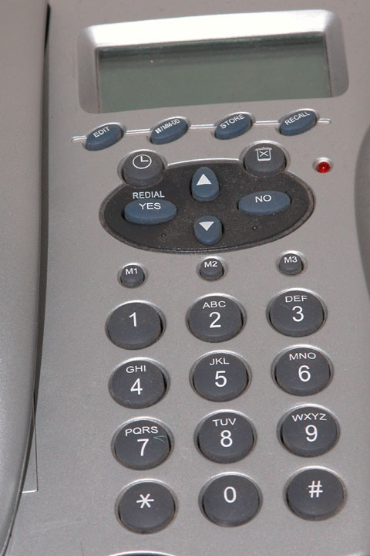
Telesales
MENU
Prospect/ cold calling - contacting customers by telephone or letter to sell your business services or products without knowing the potential client - is more acceptable now than it used to be
  It is crucial though to obtain a relevant contact name to make sure that you are talking to/ writing to the correct person (if not, you may alienate the person by showing that you did not make the effort to research them as a potential customer, and you waste your time if the letter went to the wrong person and it was discarded)
Telephone sales (telesales) centres emerged in the mid-90s and although they still exist, some businesses employ their own telesales staff as they are `closer’ to the product or service than an outsider would be. The general public tolerates telesales, but most people prefer not to be on the receiving end of a `hard sell’ telephone call.
Big business would never be conducted through telesales.
<< BACK
NEXT >>
QUESTIONS

Slide 23
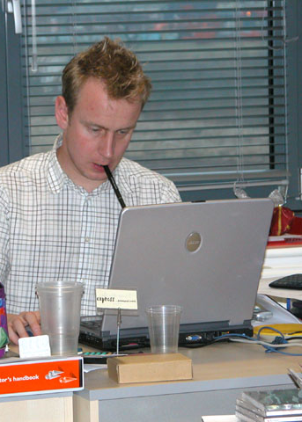
Telephone Etiquette – Emails
MENU
  Emails are one of the main forms of communication in modern business – even within a company. It is important to maintain professional communication etiquette even though these communications are more instant and sometimes not as important as other communications.
  For legal matters or very important information, letters are still sent as emails are considered more temporary and less formal in nature.
  The English consider emails typed in upper case to be poor form and rude (it is perceived to be shouting).
  Use full punctuation when emailing as this will convey tone and urgency to the email recipient.
<< BACK
NEXT >>
QUESTIONS

Slide 24
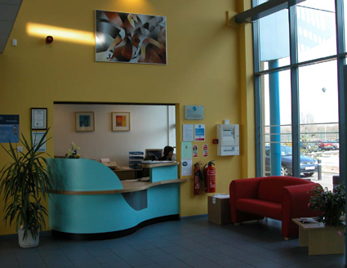
Receiving Clients
MENU
In large businesses there is usually a receptionist who greets people as they enter the building or office area. It is the receptionist’s role to:
  welcome the visitor
  find out who they are visiting
  notify the host of their visitor
  offer refreshments if appropriate
There is usually comfortable seating in the reception area just in case your host is delayed.
Small companies may not have a designated waiting area or receptionist, but visitors are still welcomed with a smile and a professional greeting.
<< BACK
NEXT >>
QUESTIONS

Slide 25
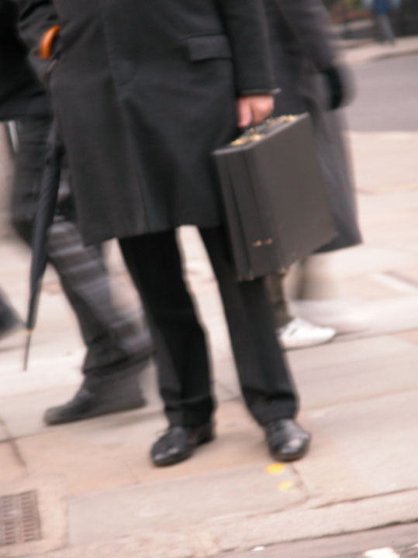
Business Dress Code – Financial Services
MENU
There is huge variety in business dress in England, and is dictated by the industry you work in.
Financial Services
The banking industry is still very formal, and clothing changes depending on your position within the bank.
Senior personnel are expected to wear suits
  Men opt for dark tailored suits and muted ties, keeping accessories to a minimum (eg: watches, wedding bands and cufflinks are expected, but ostentatious shows of jewellery are frowned upon)
  Women wear mainly dark suits (skirt or trouser suit) with simple accessories that do not attract too much attention
Other bank employees may be required to wear uniforms, or follow guidelines regarding style and colour of dress, for example:
  men - dark trousers, white shirt and a tie. Although there is a fashion trend for animated character and brightly coloured ties, these are not seen as appropriate in this environment
  Women - either wear a specific uniform provided by the bank, or dark skirt or trousers and a smart blouse
<< BACK
NEXT >>
QUESTIONS

Slide 26
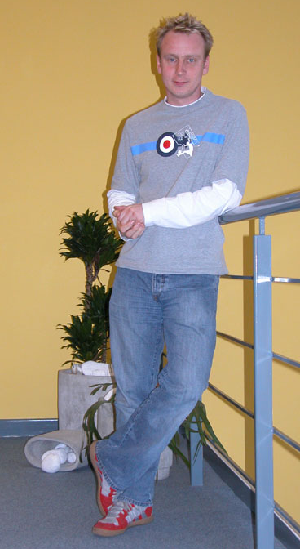
Business Dress Code – Computing
MENU
As IT is such a new industry, many of the old business rules have been altered to a reflect a more relaxed style, focusing on being comfortable whilst working, rather than making a statement about status or position.
Dress is far more casual than in other businesses and is divided into 2 categories
  Customer facing roles – business suit or smart casual wear is acceptable
  Design roles (usually limited in customer contact) – very casual; so much so that a pair of running pants and a t-shirt are acceptable.
<< BACK
NEXT >>
QUESTIONS

Slide 27
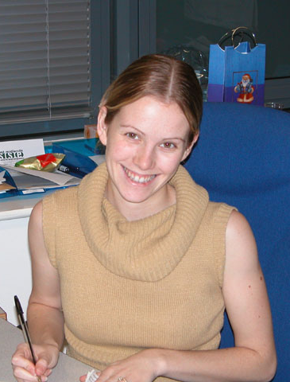
Business Dress Code – Office Environment
MENU
Offices vary in their approach to business dress, and once again it is based on what the business does and the role you have in the company.
Senior management staff and sales people invariably wear formal business dress:
  Men – business suit, matching shirt and tie
  Women – business suit (skirt or trousers) and appropriate accessories
  Sales people can get away with wearing brighter colours and accessorising more obviously as that may be a way of making their customers remember them
A word of caution: although formal business wear is usually quite conservative, women’s shirts and blouses are more low cut and figure-hugging than they were 10 years ago, so do not be offended by the amount of flesh shown in the workplace
Administrative/ support staff are dressed more casually than senior management as they are seldom in customer-facing roles
  Men – smart trousers, shirt and matching tie
  Women – smart dress or matching separates, with appropriate accessories
<< BACK
NEXT >>
QUESTIONS

Slide 28
Business Dress Code – a few tips
MENU
A few cautionary notes for formal working environments:
Men and women
  Don’t die your hair a vibrant colour (blonde, dark red or black is acceptable, but anything considered `way out’ would not be allowed)
  Don’t pierce your eyebrows, lips or put a ring through your nose (tongue piercing are acceptable as long as they do not interfere with your speech; and earrings can be hidden by hair or removed if they look overpowering)
Women
  Don’t show your belly button piercing by wearing short tops or low cut trousers
  Make sure that your underwear does not show through your clothes
  If you wear make-up to work, stick to a natural look rather than anything too dramatic
Men
  Very short hair is far more popular than it used to be and is very seldom commented upon, but some companies would find a shaven head unacceptable
  Earrings and flamboyant hand jewellery may not be approved of in the workplace
<< BACK
NEXT >>
QUESTIONS

Slide 29
Addressing Others - Language
MENU
Although the national language of the UK is English, there are different dialects and standards across the country.
Business English is known as Standard English, and although it is not as formal as the `Queen’s English’, it does not use slang. For example, when meeting someone for the first time, you could use one of the following greetings:
  “Good morning/ afternoon/ evening; it is a pleasure to make your acquaintance” (for a formal meeting with an older business person)
  “Good morning/ afternoon/ evening; it is a pleasure to meet you” (for a less formal meeting with a business person)
  It is suggested that you do not say, “Hi, good to see you.”
Language adapts to modern culture, but to ensure clear communication it is best not to use jargon with those you are doing business with unless they are in the same industry and clearly understand the terminology being used.
Language is not just about what you say, but what your body says too. Body language conveys messages all the time, and when meeting a potential business partner or customer, it is important to come across as trustworthy and genuine. A firm handshake is expected from about an arm’s length away from the person you are meeting. The English have a fairly large personal space and do not appreciate it being invaded. Kissing or hugging is not encouraged in the English business environment.
Abbreviations are acceptable in business discussions, but it is not recommended that you use them in written form unless you know the recipient well enough to be informal.
<< BACK
NEXT >>
QUESTIONS

Slide 30
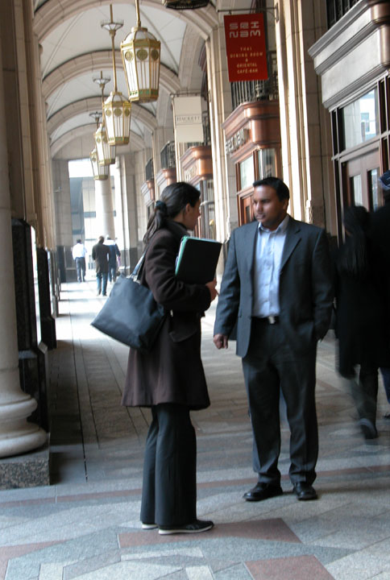
Negotiation
MENU
The English can be very subtle at negotiation and will use silence as a negotiating tool, allowing you to fill the gap and possibly give away more than you wanted to.
The `hard sell’ seldom works in English business negotiations, and can be considered vulgar.
Present your case precisely, selling your benefits rather than criticising your competitor’s product, avoid too much flattery of your client, and expect some challenging questions.
Be politically correct at all times – Equal Opportunities is taken very seriously in the UK.
Company policy will impact on decision-making, and the English may hide behind regulations to avoid disagreeable conflict.
Do not expect a decision at the close of your negotiation meeting, but your wait will not be a long one, decisions are usually reached quite quickly, and if your negotiations have been successful you will be informed of this by telephone (followed by a formal notification or contract). The English do not particularly like conflict and communicating `bad news’ directly, so you will probably received a polite letter of refusal if you have not been successful in your negotiations.
<< BACK
NEXT >>
QUESTIONS

Slide 31
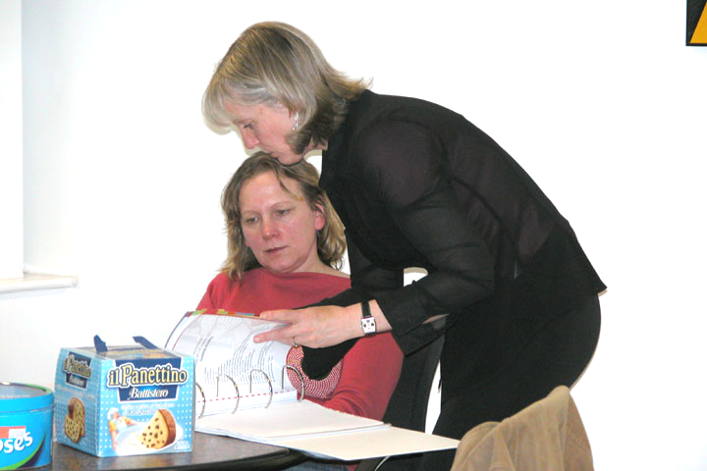
Negotiation
MENU
Far fewer people smoke than ever before, and the majority of workplaces are now smoke-free zones (or have a dedicated smoking room). It is advisable not to smoke unless invited to do so.
Body language is crucial during negotiations. It is often what is not said (and the body language observed) that conveys a message and makes or breaks a deal.
Do not smile or laugh too much as this usually comes across as false or insincere. The English sense of humour is quite dry and although business is not dull in the UK, negotiations can be quite intense.
Folding your arms is considered a barrier, so it is best to sit with your hands folded loosely in your lap or on the table in front of you.
Reclining in your chair or putting your feet on the desk is considered rude behaviour.
<< BACK
NEXT >>
QUESTIONS

Slide 32

Regional differences
MENU
Regional differences are less important than actual working environments.
Business is no longer confined to cities; better communication links (IT, phone and travel) mean people can work from almost any location in (or out) of the country.
A variety of working environments exist in the UK and these are dictated by the size of and type of business
  Home offices for the self-employed or remote employees, such as sales people
  Workshops or studios for the artist, usually found in tourist hot spots such as the Lake District or Cornwall
  Industrial estates (purpose built units on the outskirts of towns to house a number of light commercial/ industrial businesses) for small, medium or large businesses that do not rely on customers `walking past’
  Offices in town/ city centres for those whose premises may attract business from passers-by or need to be centrally located for their customers
<< BACK
NEXT >>
QUESTIONS

Slide 33
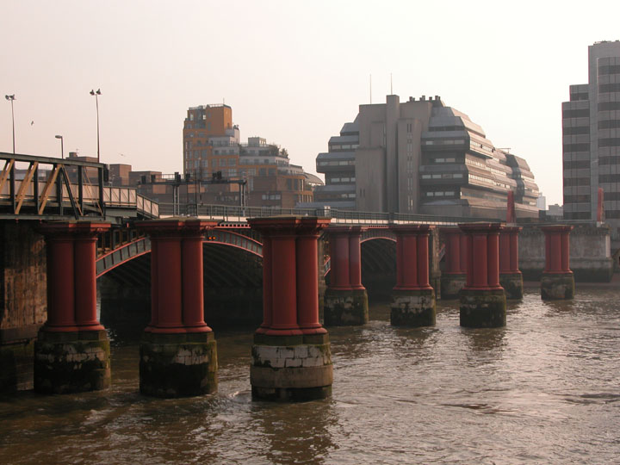
How to start a business in England
MENU
It is recognised that the world of work is changing, and large corporations do not have the monopoly on business they once had, or the hold over local communities where they were once the largest employer. Previously, any changes made to the company meant a change in the community
  Workforce redundancies and factory closures led to mass unemployment in certain geographical areas, and the resultant social issues
  Streamlining operations through the use of sophisticated technology, large corporations have reduced the workforce numbers they preciously required
The internet has changed the face of business in the last 10 years, and has impacted enormously on English business culture. E-products have swept the market by cutting out the middle-man and therefore reducing the cost of products to the consumer. As both shops and employees are `virtual’, neither working attire nor environment is a factor in their enterprise. As a result of remote trading, there is less face to face contact with competitors and customers, hence there is far less of a tightly defined English business culture than ever before. There are 3 million small businesses trading in England at the moment.
<< BACK
NEXT >>
QUESTIONS

Slide 34

How to start a business in England
MENU
The motivation for starting one’s own business is sometimes necessity, but always personal. Many people who have spent part of their careers working for others have realised that their needs are different and therefore require a different style of working, for example:
  Home-working - reduces the number of hours spent travelling to and from work (congestion on city roads is terrible), offers flexible working hours for those who have other demands on their time (eg: caring for a relative), and reduces company overheads
  Job shares and part-time roles, especially amongst women, are popular as they allow young mothers to spend more time with their children, and helps keep the cost of childcare down, and allows for other pursuits.
The skills that the majority of successful business owners have (such as enterprise and people skills) are vital to develop to ensure your business gets off the ground. And it is recommended that you have a healthy dose of perseverance, self belief, initiative and a willingness to take a calculated risk to keep it going in the early days!
<< BACK
NEXT >>
QUESTIONS

Slide 35
End of English Business Culture Module
Please click here to return to start
Please click here to start final test

